Slide 1
Marketing Analytics in Retail Banking
Nikhil Sharma
August 2019

Slide 2
01
02
03
04
05
06
07
08
Business Understanding & Impact
Process Flow
Data Overview
Exploratory Analysis
Data Cleaning, Preprocessing & Feature Engineering
Data Partitioning & Class Balancing
Model Development & Results
Recommendations
Agenda

Slide 3
Business Understanding & Impact
A Bank in Europe is looking to optimize its sales & telemarketing strategy by addressing their revenue decline, which is linked to a decrease in the number of term deposit subscriptions.
In this project we will build a predictive model for imbalanced data classification that identifies customers who have a higher probability of subscribing to a term deposit.

Slide 4
Process Flow
Correlation Analysis
Complete Dataset
Exploratory Analysis
Data Cleaning
Data Preprocessing
Logistic Regression
Grid Search with Cross Validation
Random Forest Grid Search with Cross Validation
Data Partitioning
Train/Test Set
Feature
Engineering
Balance
Data
Deploy
Model
Test
Final
Model
Model
Comparison
Neural Networks Grid Search with Cross Validation
KNN Grid Search with Cross Validation

Slide 5





Data Overview
Customer Demographics
Personal Banking
Current Marketing Campaign
Previous Marketing Campaign
Response Variable
- Age
- Job
- Marital status
- Education level
- Credit in default.
- Average account balance.
- Housing loan.
- Personal loan.
- Contact communication type.
- Last contact day of month.
- Last contact month of year.
- Last contact duration (seconds).
- Number of days after client was last contacted from previous campaign.
- Number of contacts performed before current campaign.
- Outcome of previous marketing campaigns.
- Subscription to a term deposit.

Slide 6
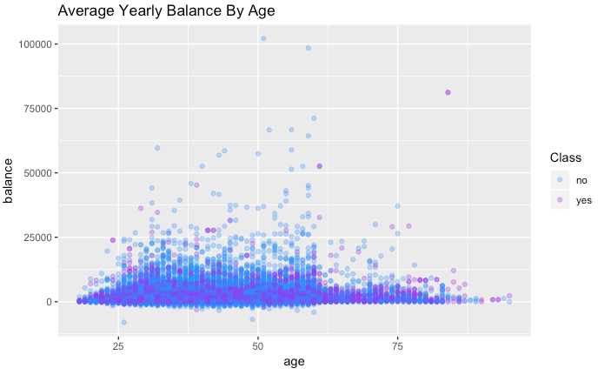
Exploratory Analysis:
Customer Demographics
Most customers spent less than 33 minutes on the phone with a Financial Advisor regardless of their education or employment level.

Slide 7
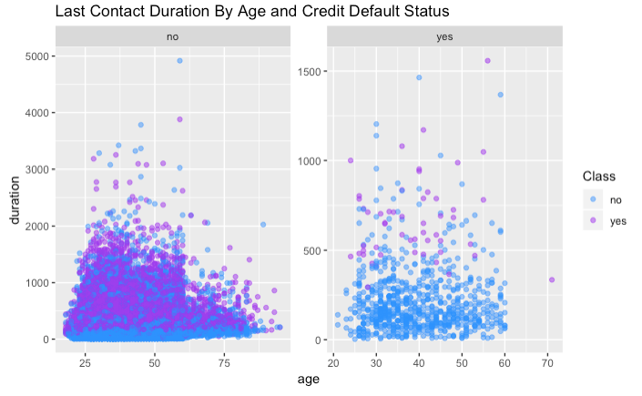
Exploratory Analysis:
Personal Banking
If a customer had a personal or housing loan, they spent less time on the phone with a Financial Advisor, and if they did have a lengthy conversation, they subscribed to a term deposit.

Slide 8
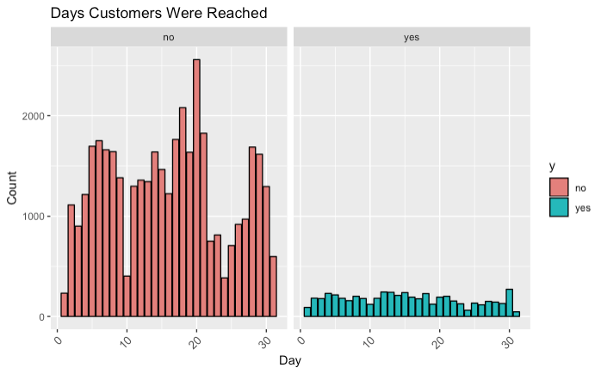
Exploratory Analysis:
Current Marketing Campaign
Most customers were reachable in the middle of the month or towards the end of the month. 47% of customers that were last contacted by the Bank in December subscribed to a term deposit.

Slide 9
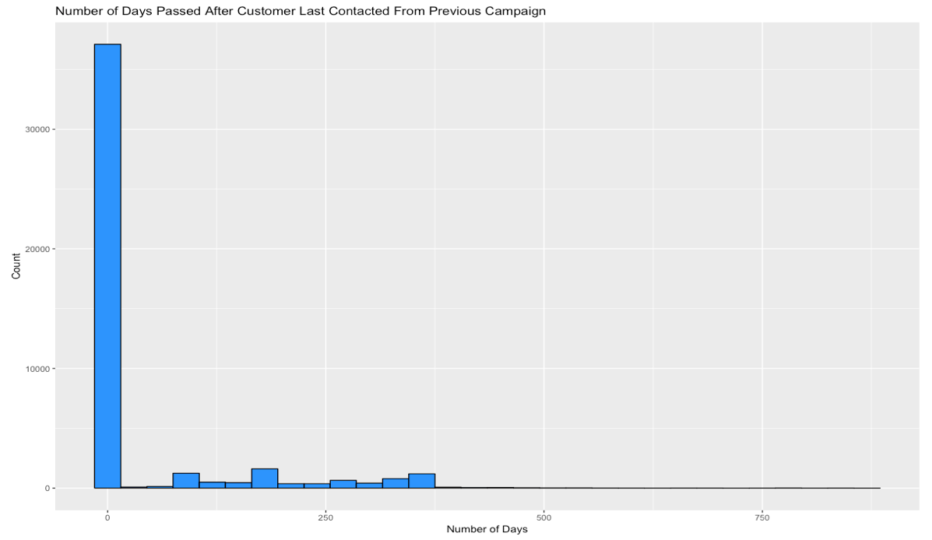
Exploratory Analysis:
Previous Marketing Campaign
Average number of days the customer was last contacted after the previous campaign was 40 days. 75% of customers were not contacted by the Bank prior to the campaign.

Slide 10
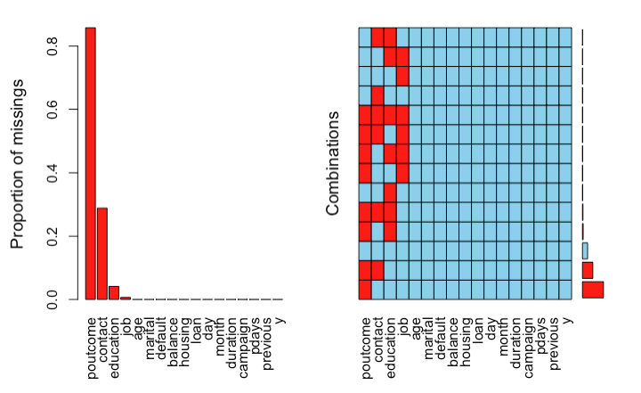
Data Cleaning: Missing Values & Duplicates
Multivariate Imputation by Chained Equations (MICE) was used to impute 53,964 missing values. There were zero duplicates in the dataset.

Slide 11

Data Preprocessing
& Feature Engineering
Categorical values for the variable ‘job’ were bucketed into ‘unemployed’ and ‘employed’ to better identify records in a shared a group to enhance algorithmic efficiency.
Numeric variables were then scaled and centred. Scale transform calculates the standard deviation for each feature and divides each value by that output. Meanwhile, center transform calculates the mean for each feature and subtracts it from each value.
One-Hot Encoding was used to treat categorical variables, where every unique value is added as a feature in the data set as a binary predictor (0,1).

Slide 12
Data Partitioning
Class Balancing
80%
The dataset is highly imbalanced with over 80% of customers being non-subscribers. SMOTE was used to balance the training data set. If imbalanced data is trained on the classifier, the results may be biased in favour of the majority class because there weren’t enough data points to learn about the population of the minority class. Here were some of the options:
Oversampling: Minority class is duplicated until the class balance is achieved.
Under-sampling: Removes the random instances of the majority class. Although the results may be strong, the model suffers from a significant loss of data points and ends up not generalizing well enough.
Synthetic Minority Over-Sampling Technique (SMOTE): Balances the skewed class distribution of positives and negatives.
Training Data
K-Fold Cross Validation
20%
Test Data

Slide 13



Performance Metrics
01
ROC
02
Recall or Sensitivity
03
Precision
Used to evaluate how well a model can distinguish between classes when predicting. Higher the AUC (Area Under the Curve) or closer to 1, the stronger the model is at predicting the binary classes correctly.
Indicates the percentage of correct positive classifications (true positives) from respondents that are positive. In other words how many customers were correctly classified as term deposit subscribers by the model.
Indicates the percentage of correct positive classifications (true positives) from respondents that were predicted as positive. In other words, how many customers were correctly classified as non-subscribers and subscribers, respectively.

Slide 14
Cross-Validation
Evaluation
Confusion Matrix
ACTUAL VALUES
We need to be able to answer what is the cost of incorrectly classifying a customer who is a non-subscriber as a subscriber (false positive or Type I Error cost = marketing) versus what is the cost of failing to identify a customer who is a subscriber as a non-subscriber (false negative = revenue).
When it comes to Bank marketing, false positives are inexpensive compared to false negatives or Type II, which could lead to sales opportunities.
PREDICTED VALUES
YES
NO
YES
TRUE POSITIVE
FALSE POSITIVE
NO
FALSE NEGATIVE
TRUE NEGATIVE

Slide 15
Cross-Validation
Results
Model Performance
After 10-fold cross validation Random Forest Model had the highest ROC average over 30 resamples, including the highest sensitivity, also known as true positive rate or recall.

Slide 16
Model Tuning: Types of Feature Selection Methods
Wrapper Method
“Evaluates multiple models using procedures that add and/or remove predictors to find the optimal combination that maximizes model performance,” (Kuhn, 2019).
Filter Method
“Evaluates the relevance of the predictors outside the predictive models and subsequently model only the predictors that pass some criterion,” (Kuhn, 2019).

Slide 17
Model Tuning:
Recursive Feature Elimination
Recursive Feature Elimination fits a model using all variables and calculates the importance or rank for each variable. The worst performing variables are eliminated at each iteration and the model is retrained to compute the importance for each variable. The feature selection process is repeated until the best subset of predictors are selected based on the highest variable importance with 10-fold cross- validation.
The original model that included all 28 predictors performed better:
Able to better distinguish between classes.
High sensitivity means few false negatives (incorrectly predicting subscriber as a non-subscriber).
Low specificity means many false positives (incorrectly predicting non-subscriber as a subscriber).
False positives are less costly compared to false negatives because the Bank would rather pay the marketing cost it would take to call the occasional customer who chooses not to subscribe rather than missing out on actual sales opportunities.

Slide 18
Test Results
Performance Metrics
Model Deployment
Evaluation
Percentage of how strong the model is in distinguishing between classes remains >90%.
Model is able to achieve a >80% true positive rate which means few false negatives (incorrectly predicting subscriber as a non-subscriber)
PRECISION
AUC - ROC
RECALL
0.464
0.931
0.840

Slide 19
High False Positive Rate & Low False Negative Trade-Off
The model achieves a low precision rate which indicates a high false positive rate i.e. how many customers were correctly classified as non-subscribers and subscribers, respectively.
However, the model achieved a >80% true positive rate which means few false negatives (incorrectly predicting subscriber as a non-subscriber).
False positives are less costly compared to false negatives because the Bank would rather pay the marketing cost it would take to call the occasional customer who chooses not to subscribe rather than missing out on sales opportunities.

Slide 20
Recommendations
While the dataset does not provide the cost of each phone call, the efficiency of the Bank’s telemarketing strategy was improved with the assumption that it will result in time and cost reduction of advisors making phone calls to customers who are likely to subscribe to a term deposit.
The length of call was the most important feature followed by whether the client was known to the bank; the day the call was made, and how much money was in the client’s account and the age of the a client.

